Slide 1

Generative AI: Ushering in a New Era of Innovation
Welcome to a journey into the transformative power of Generative AI. We'll explore how this groundbreaking technology is reshaping industries, augmenting human potential, and driving unprecedented innovation.

Slide 2
What is Generative AI?
Generative AI is a subset of Artificial Intelligence that excels at creating new, original content across various mediums—be it text, images, music, or even code. Unlike traditional AI that primarily analyses existing data, Generative AI fabricates novel outputs, mimicking human creativity.
This capability is powered by advanced machine learning models, primarily:
Generative Adversarial Networks (GANs): Known for hyper-realistic image generation.
Variational Autoencoders (VAEs): Used for generating diverse data samples.
Transformer Models (e.g., GPT-4): Revolutionising natural language processing and understanding.

Slide 3
The Technology Behind the Magic
Generative Adversarial Networks (GANs)
Variational Autoencoders (VAEs)
Transformer Models
Utilise attention mechanisms to weigh the importance of different parts of the input data, enabling a deep understanding of context. This powers coherent text generation, language translation, and complex problem-solving capabilities.
Comprise two competing neural networks: a 'Generator' that creates content and a 'Discriminator' that evaluates its authenticity. Through this adversarial process, GANs learn to produce remarkably realistic outputs.
Work by encoding input data into a lower-dimensional representation (latent space) and then decoding it to generate new, similar data points. They excel at creating novel variations of existing data.

Slide 4

Generative AI's Rapid Rise
The ascent of Generative AI has been nothing short of meteoric. The launch of OpenAI's ChatGPT, for instance, garnered over 100 million users within a staggering 60 days in early 2023, showcasing an unprecedented adoption rate.
From automating coding functions to generating intricate art pieces, GenAI is fundamentally reshaping workflows and creative processes across countless industries. As Michael Carbin of MIT aptly put it, Generative AI represents "the most powerful communication shift since the desktop computer."

Slide 5




Transforming Industries: Real-World Impact
Generative AI is not merely a theoretical concept; it's actively revolutionising diverse sectors:
Software Engineering
Creative Arts
Boosts productivity through AI-assisted coding, automated testing, and accelerated design cycles, allowing developers to focus on higher-value tasks.
Artists and designers leverage AI for brainstorming, generating concepts, and producing novel works, pushing the boundaries of creative expression.
Education
Healthcare
Enhances learning by creating personalised content, supporting critical thinking, and offering dynamic educational tools tailored to individual needs.
Generates synthetic patient data for research, accelerates drug discovery, and aids in personalised intervention planning, improving patient outcomes.

Slide 6

Case Study: AI in Software Development
In the realm of software development, Generative AI tools are proving indispensable. They can:
Generate initial code drafts from natural language prompts.
Translate code between different programming languages.
Create comprehensive test cases and automate debugging processes.
This automation frees developers from repetitive, mundane tasks, allowing them to redirect their expertise towards innovation, complex problem-solving, and architectural design. The synergy between human engineers and AI leads to faster development cycles, higher code quality, and ultimately, more robust software solutions.

Slide 7
Ethical and Practical Challenges
As with any powerful technology, Generative AI presents its own set of challenges that demand careful consideration and proactive solutions.
Bias in AI Outputs
AI models can inadvertently perpetuate biases present in their training data, leading to skewed or unfair results. Rigorous testing and diverse datasets are crucial.
Data Privacy Concerns
The vast amounts of data required for training raise questions about privacy, consent, and the potential for misuse of sensitive information.
Academic Integrity Issues
The ability to generate human-like text poses challenges for academic assessment and originality, necessitating new educational approaches.
Importance of Human Oversight
AI should be viewed as a powerful collaborator, not a replacement. Human critical thinking, ethical judgment, and creative direction remain paramount.
Responsible AI Adoption
Transparent governance frameworks, clear ethical guidelines, and continuous education are vital for the responsible development and deployment of GenAI.

Slide 8




The Future Landscape
The trajectory of Generative AI points towards pervasive integration across all facets of business and creative endeavours.
Augmented Human Creativity
1
AI will increasingly act as a creative partner, enhancing human capabilities and accelerating artistic and intellectual output.
Dynamic Content Generation
2
Expect real-time, on-demand creation of adaptive content, from personalised marketing materials to interactive learning experiences.
Ubiquitous Integration
3
GenAI will become an invisible layer powering everyday tools and processes, from software interfaces to decision-making systems.
Personalised User Experiences
4
AI will tailor interactions and content to individual users with unprecedented precision, creating highly engaging and relevant digital environments.

Slide 9
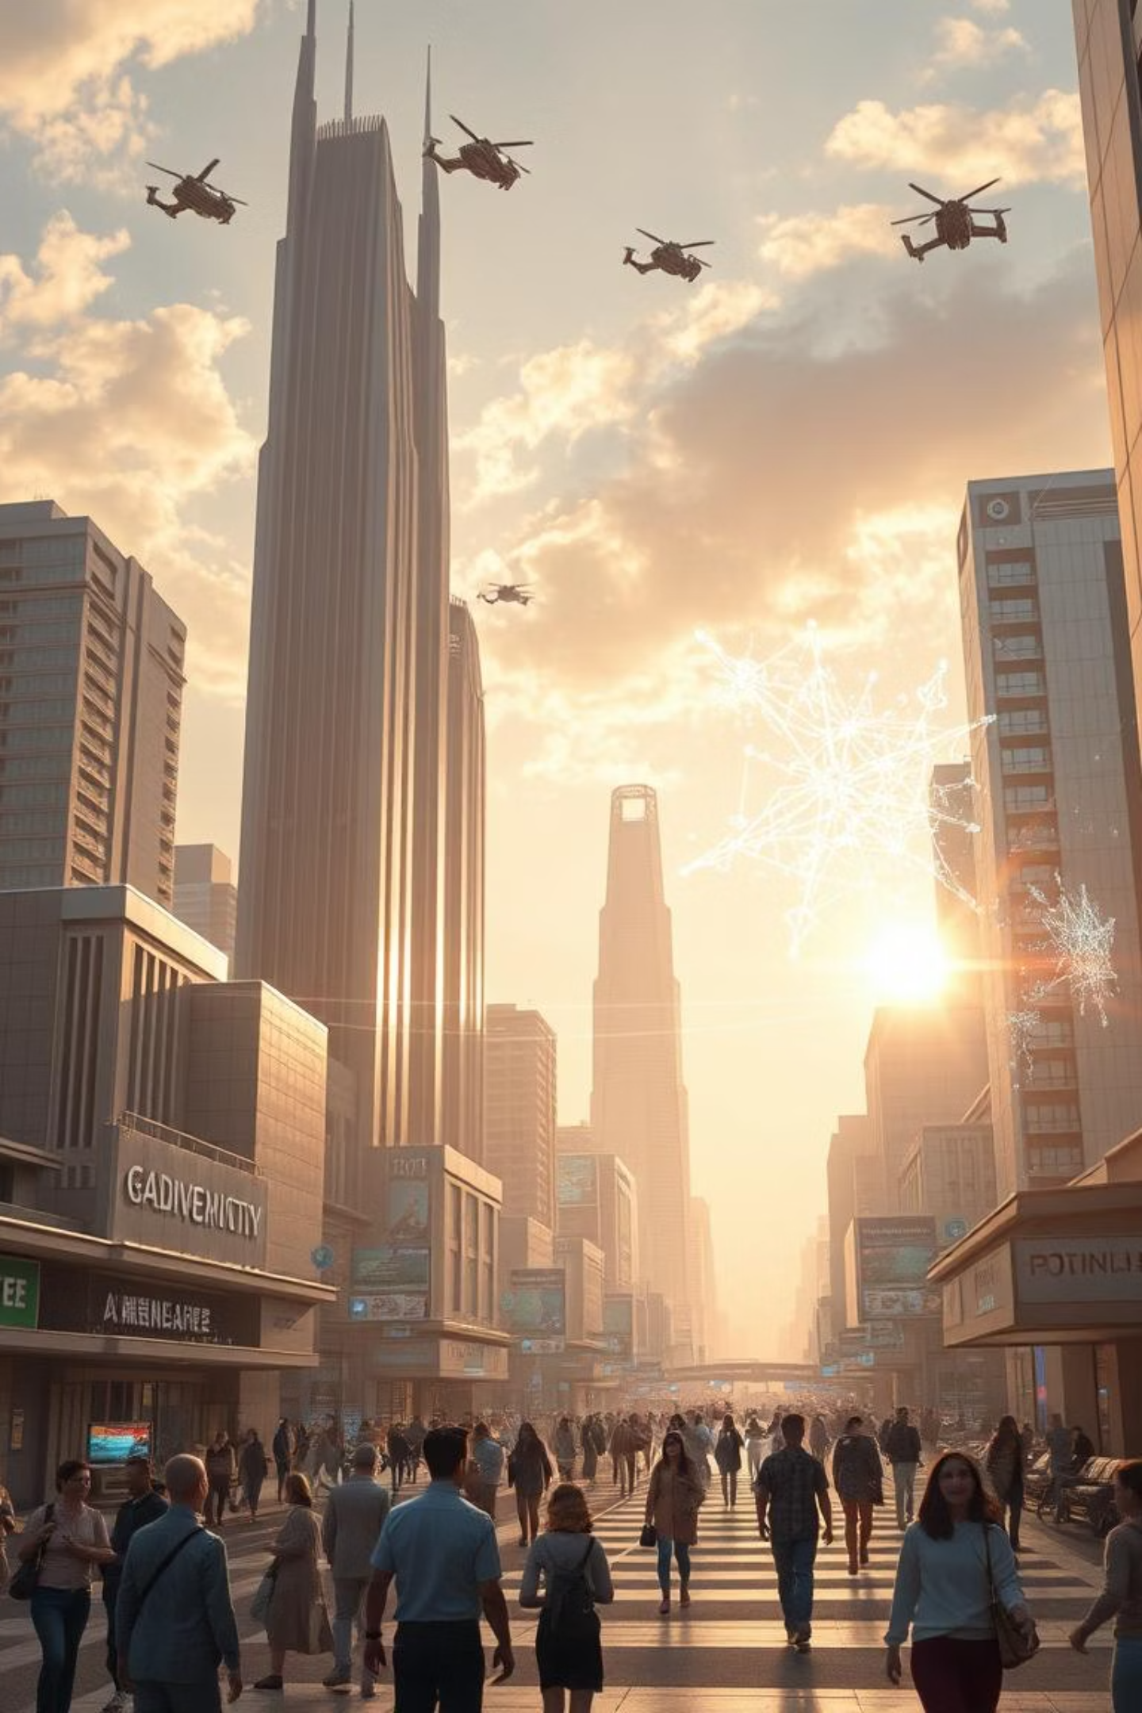
Visualising the New Era
Generative AI: Empowering Human Potential

Slide 10
Conclusion: Embrace the Generative AI Revolution
Generative AI is not merely a technological advancement; it is a profound catalyst for a new era—one defined by enhanced creativity, unprecedented productivity, and boundless innovation.
Success in this new landscape will depend not on replacing human insight, but on blending it harmoniously with the extraordinary capabilities of AI.
The future belongs to those who actively embrace this powerful partnership, harnessing its potential to transform visionary ideas into tangible realities. Let's work together to build this future.

